Slide 1
New York State Required Labs – Review
Diffusion Through A Membrane
Making Connections
Beaks of Finches
Relationships and Biodiversity

Slide 2
Diffusion Through a Membrane

Slide 3
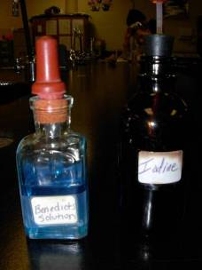
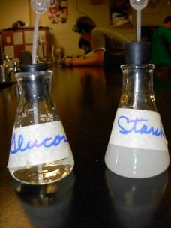
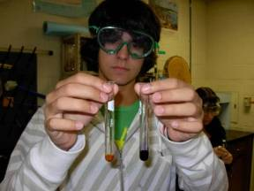
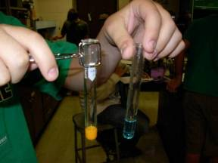
Diffusion Through A Membrane
indicator – chemically indicates if a substance is present by changing color
iodine = starch indicator solution
Benedict’s solution = glucose indicator solution – must be heated

Slide 4
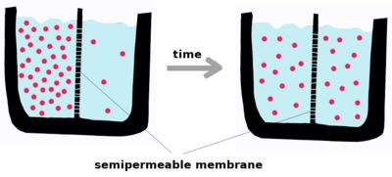
Diffusion Through A Membrane
diffusion – movement of molecules from a region of high concentration to a region of low concentration – no energy needed (passive transport)

Slide 5
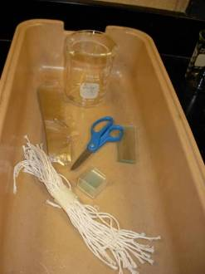
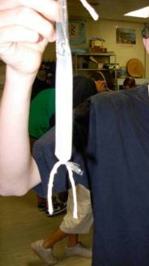
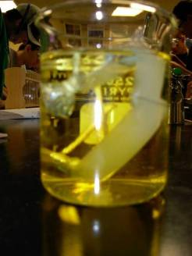
Diffusion Through A Membrane
we used a dialysis tube to simulate a semi-permeable cell membrane
the dialysis tube was filled with glucose solution and starch solution, sealed
and rinsed with water
it was placed in a beaker with water and iodine and allowed to sit

Slide 6
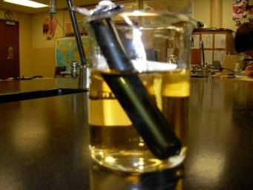
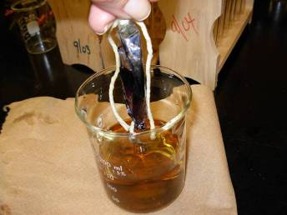
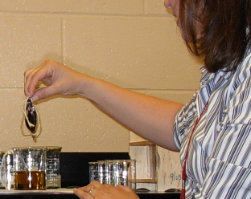
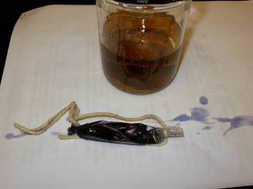
Diffusion Through A Membrane
results of
starch test –
inside and
outside of cell

Slide 7
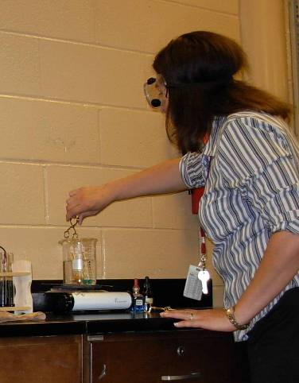
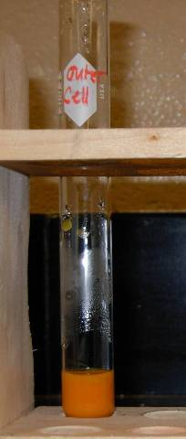
Diffusion Through a Membrane
results of glucose
test – outside of cell

Slide 8
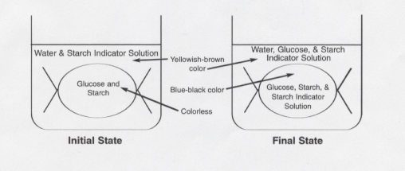
Diffusion Through a Membrane

Slide 9
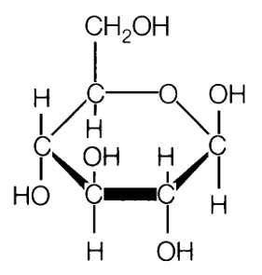
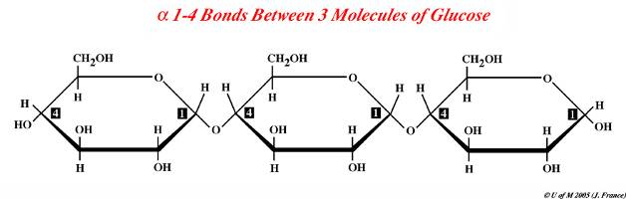
Diffusion Through A Membrane
glucose molecule
part of a starch
molecule

Slide 10
Diffusion Through a Membrane
osmosis – diffusion of water across a semi-
permeable cell membrane from region of high
concentration to a region of low concentration –
no energy needed (passive transport)

Slide 11
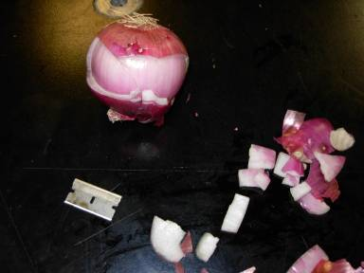
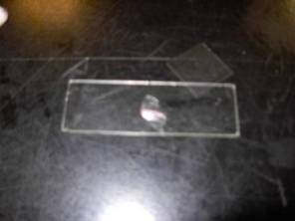

Diffusion Through a Membrane

Slide 12
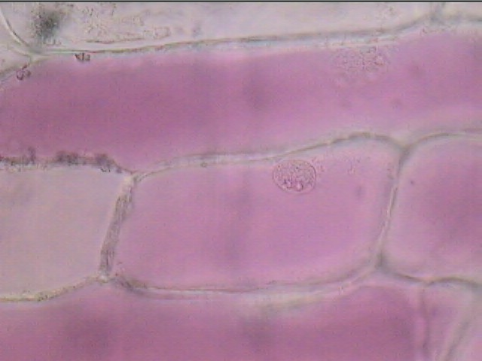

Diffusion Through a Membrane
cytoplasm
red onion cells
in tap water
cell membrane
cell wall

Slide 13
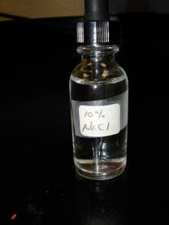
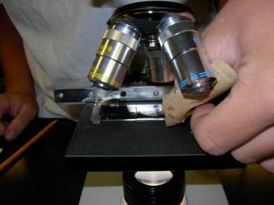
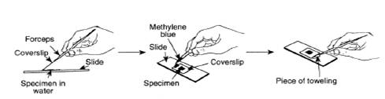
Diffusion Through a Membrane
bathing the cells in
10% NaCl = salt
water, by “wicking”
it through
NaCl

Slide 14
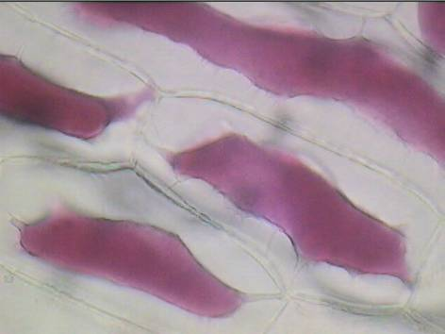
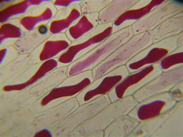
Diffusion Through a Membrane
cytoplasm
red onion cells in
salt water
cell membrane
cell wall

Slide 15
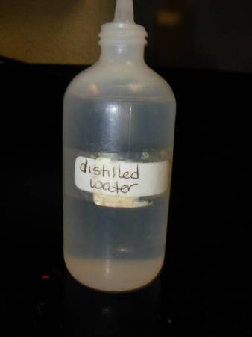
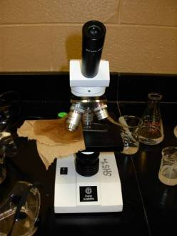
Diffusion Through A Membrane
bathing the cells in
distilled water,
by “wicking” it
through

Slide 16
Diffusion Through a Membrane
cytoplasm
red onion cells
in distilled water –
returned to normal
cell membrane
cell wall

Slide 17
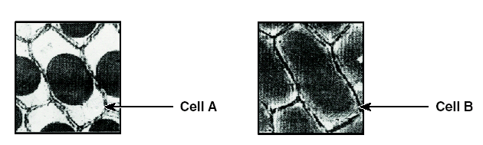
Diffusion Through A Membrane
Which is in distilled water and
which is in salt water?

Slide 18
Diffusion Through A Membrane
Applications –
salt on roads to melt snow
intravenous saline solutions
salty foods make you thirsty
salt on slugs to kill them
salty foods do not spoil as easily
gargling with salt water
digestion of starch to glucose

Slide 19
Making Connections

Slide 20
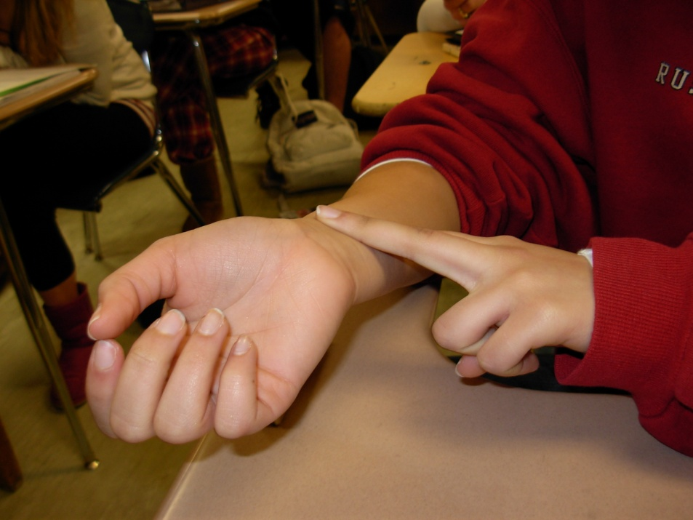
Making Connections –
Part A: Looking for Patterns A1. What Is Your Pulse Rate?
pulse – results from expansion of
arteries each time your heart
beats to send a surge of blood
through your body
measured pulse three times and found average pulse rate
tallied class average pulse rates

Slide 21
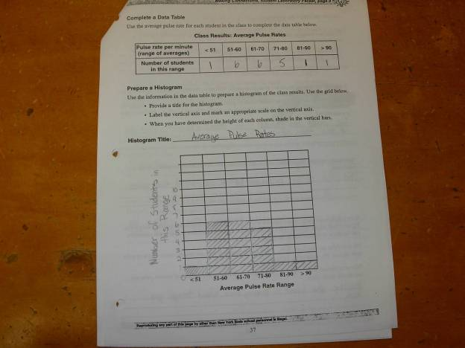
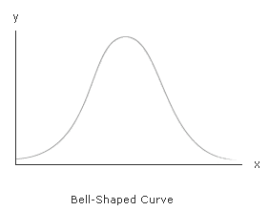
Making Connections –
Part A: Looking for Patterns A1. What Is Your Pulse Rate?

Slide 22
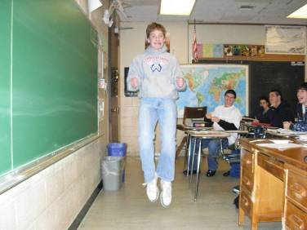

Making Connections –
Part A: Looking for Patterns A1. What Is Your Pulse Rate?
after exercise, pulse increased
heart beats faster - increasing circulation - to carry more
oxygen and nutrients to the cells of the body
breathe faster to obtain more O₂ and release CO₂
respiratory and circulatory systems working together to maintain homeostasis

Slide 23
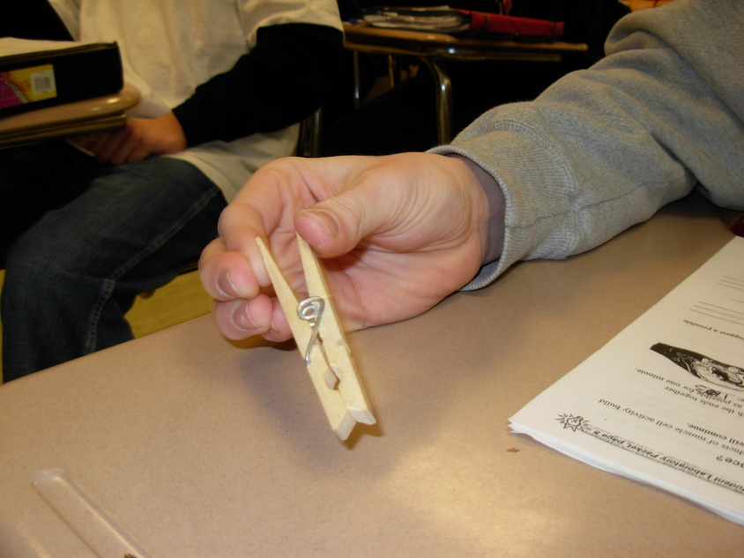
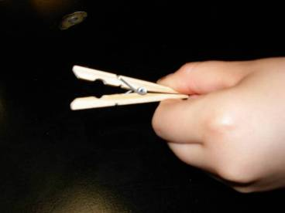
Making Connections – Part A: Looking for Patterns A2. How Does Fatigue Affect Muscle Performance?
squeezed clothespin for one minute – counted
squeezed again for one minute using same hand
the second time number of squeezes was lower due
to muscle fatigue

Slide 24
Making Connections – Part B: Investigating Claims
claims are accepted if there is evidence to support them
Student A
claims more clothespin
squeezes in 1 minute if
exercises 1st – faster
pulse rate, blood
getting to muscles faster
Student B
claims more clothespin
squeezes in 1 minute if
rests 1st – exercise uses
energy - resting person
will have more energy
conduct a controlled experiment to determine
which claim is correct

Slide 25
Making Connections – Part B: Investigating Claims
Experimental Design
Question: Can you squeeze a clothespin more
times in one minute if you exercise or rest beforehand?
Hypothesis: (tentative statement about the expected
relationship between the variables) You can squeeze a
clothespin more times in one minute if you rest first.
Title: The Effect of Exercise and Rest on Clothespin
Squeezing Rate

Slide 26
Making Connections – Part B: Investigating Claims
Experimental Design
Dependent variable: (what you measure) number of times
the clothespin can be squeezed in one minute
Independent variable: (the one we vary to see how it
affects the dependent variable) amount of exercise
Variables that must be controlled (kept constant):
type of clothespin fingers used
time of exercise/rest time of squeezing
same hand for each trial
* use maximum sample size and number of trials in experiment *

Slide 27
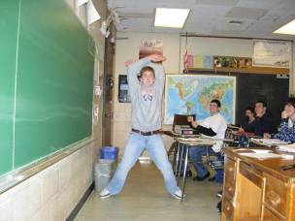

Making Connections – Part B: Investigating Claims
Experimental Design
half of class rests and half of class exercises – then all
count number of clothespin squeezes in one minute
OR
whole class rests and counts number of clothespin squeezes
in one minute – then whole class exercises and counts
number of clothespin squeezes

Slide 28
Making Connections – Part B: Investigating Claims
Final Report
Title
Hypothesis
Materials and Methods – materials used and what you did
Data Collected – includes data tables and graphs
Discussion and Conclusions – does data support or refute
hypothesis and explanation
Suggestions for Improvement – sources of error, variables
that must be controlled and that influenced outcome
Suggestions for further research – new research questions

Slide 29
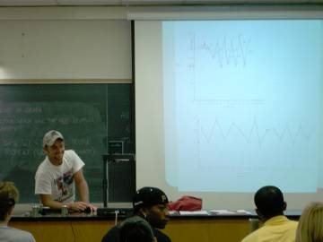
Making Connections – Part B: Investigating Claims
Peer Review
Defending findings and conclusions to peers:
presentation
address final report
answer questions
visual aids
Results and conclusions accepted if they can be repeated
by other scientists

Slide 30
Beaks of Finches

Slide 31
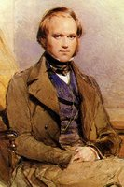
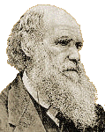
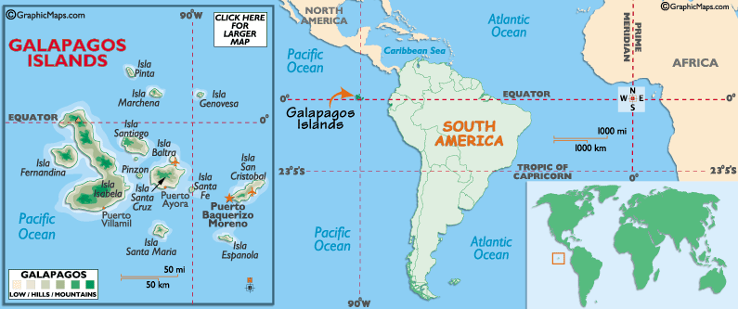
Beaks of Finches
Charles
Darwin

Slide 32
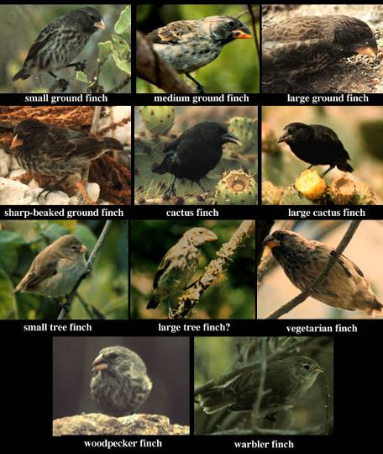
Beaks of Finches
Darwin’s finches show
great variation in beak
adaptations – shapes
and sizes - due to
isolation of bird
populations on islands
with different kinds and
amounts of food

Slide 33
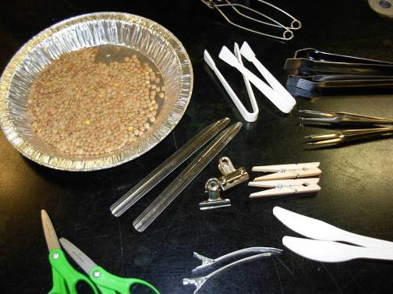
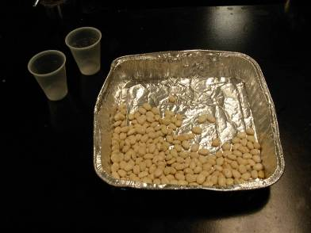
Beaks of Finches
different tools represent different beaks
seeds (small and large) represent food
tray represents the island
cup represents finch stomach

Slide 34
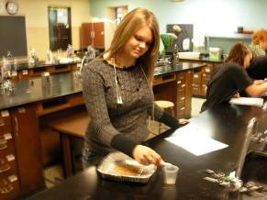
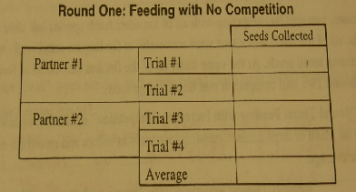
Beaks of Finches
Round One: No Competition, Original Island
feeding with no competition - one person at a time
feeding on small seeds
as many as possible in given time
repeated twice with each person = 4 trials total
average of 13 or greater survived
average of less than 13 moved to new island

Slide 35
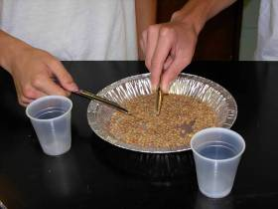
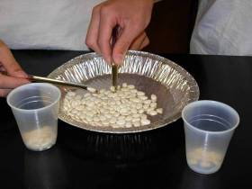
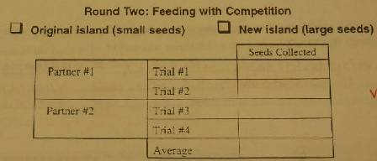
Beaks of Finches
competition – interaction between two or more individuals
to obtain a resource that is in limited supply
Round Two: Competition
on original island with small
seeds (if survived round 1)
on new island with large seeds
(if did not survive round 1)
competition – feeding with
another team from same dish

Slide 36
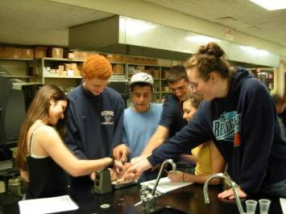
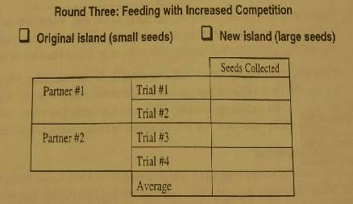
Beaks of Finches
Round Three: Increased Competition
competing with all other species left on your island
all successful at feeding on small seeds at one dish
all successful at feeding on large seeds at another dish

Slide 37
Beaks of Finches
This activity simulates concepts involved in
natural selection:
variation – different beak types and seed sizes
competition – more than one bird feeding at a time
struggle for survival – each bird trying to get enough
to survive
adaptation – particular characteristics of each beak
environment – the birds, food and island
selecting agent – the size of seed available
Notes:
37

Slide 38
Beaks of Finches
Overall:
some birds had beaks that allowed them to survive
on small seeds
- if a bird survives it can reproduce
- it may then pass its traits on to its offspring
other birds could not survive on small seeds,
but could survive on large seeds
still other birds could not survive on either size seed
over time adaptive radiation occurred - new
species evolved from a common ancestor – each
new species occupies a different habitat or
ecological niche (in this case with different food)

Slide 39
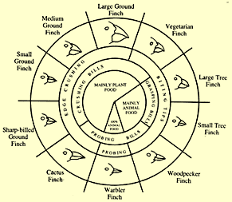

Beaks of Finches
Different finches have
beaks with different
characteristics that allow
them to compete
successfully on different
types of food – each
species has its own niche,
which limits competition
In order for a species to survive, the appropriate type
of food must be available.

Slide 40
Relationships and Biodiversity

Slide 41
Relationships and Biodiversity
Botana curus – hypothetical plant
used to make Curol – for treating cancer
Botana curus – endangered, grows slowly
related species: X, Y and Z
will determine which is most closely related to Botana Curus using structural and molecular evidence
will decide which species (X, Y or Z) is most likely to produce Curol

Slide 42




Relationships and Biodiversity
Structural Evidence – Test 1:
Structural Characteristics of Plants

Slide 43




Relationships and Biodiversity
Structural Evidence – Test 2:
Structural Characteristics of Seeds
Notes:
43

Slide 44


Relationships and Biodiversity
Structural Evidence – Test 3:
Microscopic Internal Structure of Stems
examined cross section
of stem under microscope
to determine arrangement
of vascular bundles
Notes:
44

Slide 45


Relationships and Biodiversity
Structural Evidence – Test 3:
Microscopic Internal Structure of Stems
Botana curus
scattered
bundles
Species X
circular
bundles
Species Y
circular
bundles
Species Z
scattered
bundles
Notes:
45

Slide 46
Relationships and Biodiversity
Hypothesis after examining
structural evidence is that
Botana curus is most closely
related to species Z.
Notes:
46

Slide 47


Relationships and Biodiversity
Molecular Evidence – Test 4:
Paper Chromatography to Separate
Plant Pigments
pigments – absorb sunlight in plants,
give plants color, ex: chlorophyll
pigments extracted from each species
placed on chromatography paper
chromatography paper placed in water
Notes:
47

Slide 48




Relationships and Biodiversity
Molecular Evidence – Test 4:
Paper Chromatography to Separate
Plant Pigments
Notes:
48

Slide 49




Relationships and Biodiversity
Molecular Evidence – Test 4:
Paper Chromatography to Separate
Plant Pigments
Notes:
49

Slide 50

Relationships and Biodiversity
Molecular Evidence – Test 5:
Indicator Test for Enzyme M
Notes:
50

Slide 51




Relationships and Biodiversity
Molecular Evidence – Test 5:
Indicator Test for Enzyme M
Botana curus
enzyme M present
Species X
enzyme M absent
Species Y
enzyme M present
Species Z
enzyme M present
Notes:
51

Slide 52

Relationships and Biodiversity
Molecular Evidence –
Test 6: Using Simulated
Gel Electrophoresis
To Compare DNA
Notes:
52

Slide 53

Relationships and Biodiversity
Molecular Evidence – Test 6: Using Simulated
Gel Electrophoresis To Compare DNA
Notes:
53

Slide 54


Relationships and Biodiversity
Molecular Evidence – Test 6: Using Simulated
Gel Electrophoresis To Compare DNA
Notes:
54

Slide 55


Relationships and Biodiversity
Molecular Evidence – Test 6: Using Simulated
Gel Electrophoresis To Compare DNA
Notes:
55

Slide 56

Relationships and Biodiversity
Molecular Evidence – Test 7: Translating
the DNA Code to Make a Protein
Notes:
56

Slide 57

Relationships and Biodiversity
Molecular Evidence –
Test 7: Translating
the DNA Code to
Make a Protein
Notes:
57

Slide 58

Relationships and Biodiversity
Notes:
58

Slide 59

Relationships and Biodiversity
Which species – X, Y or Z - is most similar to Botana curus and is most likely to produce Curol?
Which kind of evidence – structural or molecular – is most helpful to make decisions about relationships between species?
Which evolutionary tree diagram best shows the
  relationships between species used in this lab?
Notes:
59

Slide 60
Relationships and Biodiversity
biodiversity – a measure of the number
and types of organisms in a location
helps maintain ecosystem stability
useful to humans for food, medicine,
    clothing, shelter, oxygen, soil fertility,
future genetic variation, enjoyment
we have no right to destroy
Notes:
60

Slide 61
Relationships and Biodiversity
extinction – no more of a given species
left on earth
causes of extinction and loss of biodiversity:
  destruction of natural habitats
  pollution
  overharvesting
  invasive species
  removal of predators

Slide 62
Relationships and Biodiversity
Human activities are reducing biodiversity
and are causing the extinction of real
organisms that have real uses, like the
hypothetical Botana curus. Many people
feel that it is important to preserve
biodiversity. Some do not feel that it is
worth the cost and effort.

Slide 63
New York State Required Labs
Diffusion Through A Membrane
Making Connections
Beaks of Finches
Relationships and Biodiversity

